Slide 1
MAROM
Creation and use of API for easy creation of RDF triples from web pages

Slide 2
RDF
RDF is a standard format for representing data in such a way that
Computers can “understand”, and independently deduce additional data. The collection of various RDF web pages are an important part of the “semantic web.
RDF document is made of triples in the form (subject, predicate, object), each triple declare a certain relation between the subject and the object, and this relation is defined by the predicate.
Text: Daniel is 27 years old RDF triple: (Daniel,age,27)

Slide 3
Ontologies
To describe the various forms of information which can be presented by RDF triples we use special vocabularies which called ontologies.
There are many different ontologies intended for different subjects.
In this project the main ontology been used is FOAF.

Slide 4
How to extract the data we need?
We have a website with plenty of useful data that we want to turn into RDF triples. How can we do that?
If we have access to the site database, then it should be easy. But what if we don’t have the access?
In this case, we have to extract the data from the html pages.
This task can be much more challenging.
The project’s goal: create a (relatively) simple interface to turn data in html pages into RDF triples

Slide 5
The tools
Xpath – a standard way to extract data from XML files. Using the special hierarchical structure of XML you create queries which navigate the file and extract the required data.
Python – the interface is in the form of a python module, which create a comfortable API for easy data extraction and transformation to RDF triples.

Slide 6
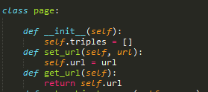
The module
The module define the class Page and several class methods.
The user provide the class with information on the page URI, the Xpath queries needed to achieve the required data, and how to create a triple from the extracted data. The triples are stored in the page object, and at the end of the triples creation they can be automatically turn into RDF document in a turtle format.

Slide 7
Using The module
The module has been used to create RDF files from several pages of the computer science department website. The ontology used was the FOAF ontology.

Slide 8
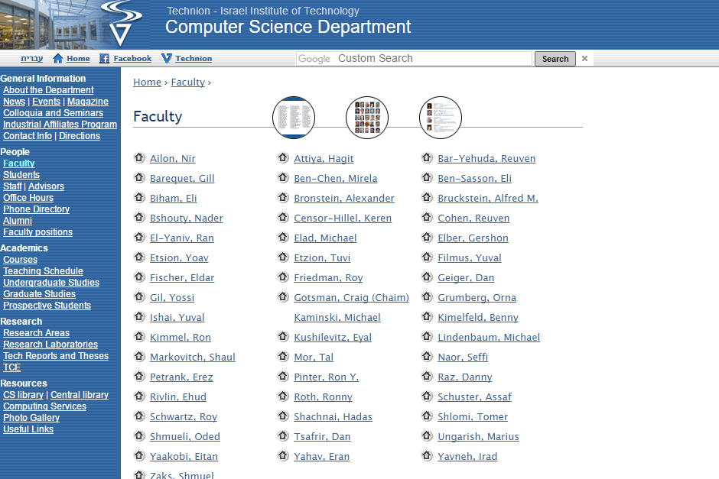
CS department – Faculty page

Slide 9
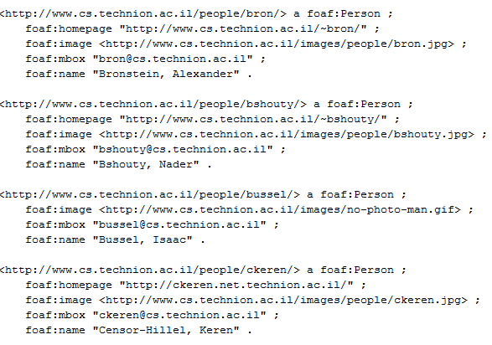
CS department Faculty page – converted to RDF (turtle format)

Slide 10
Creating RDF from questions and answers collection
another use of the module was transforming the data in the questions and answers pages of the site www.yeshiva.org.il into RDF, including the definition of special ontology for the specific type of data.

Slide 11
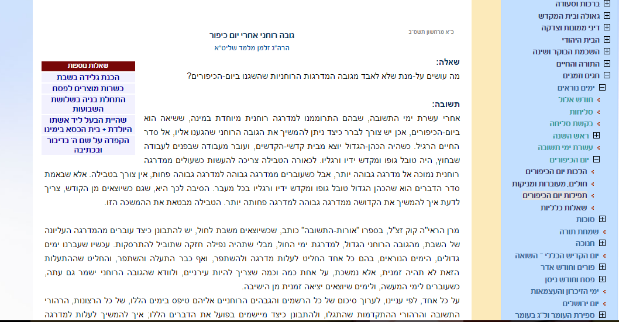
Question and answer page

Slide 12
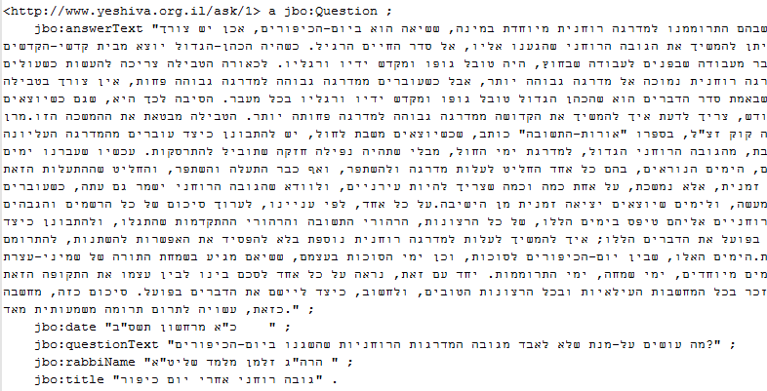
Conversion to RDF

